Slide 1

Three Ways of Deleting List Members

Slide 2
Reference
stackoverflow
Youtube
Code

Slide 3
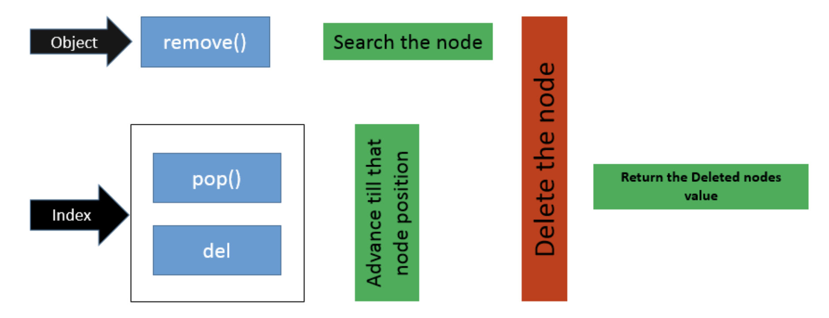
stackoverflow

Slide 4
Remove first object

Slide 5
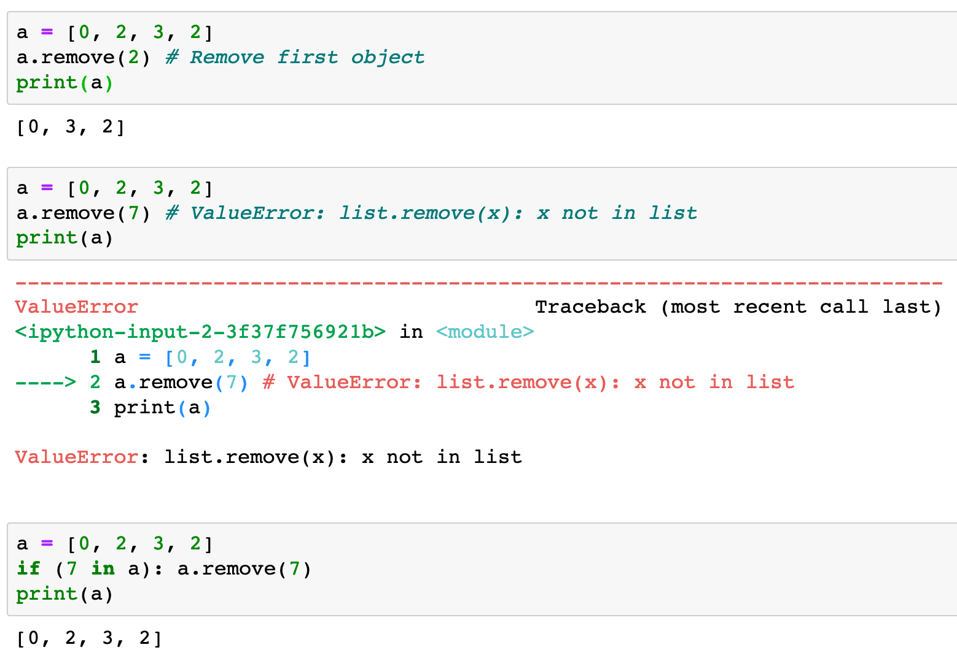


Slide 8
Delete an index item or items

Slide 9
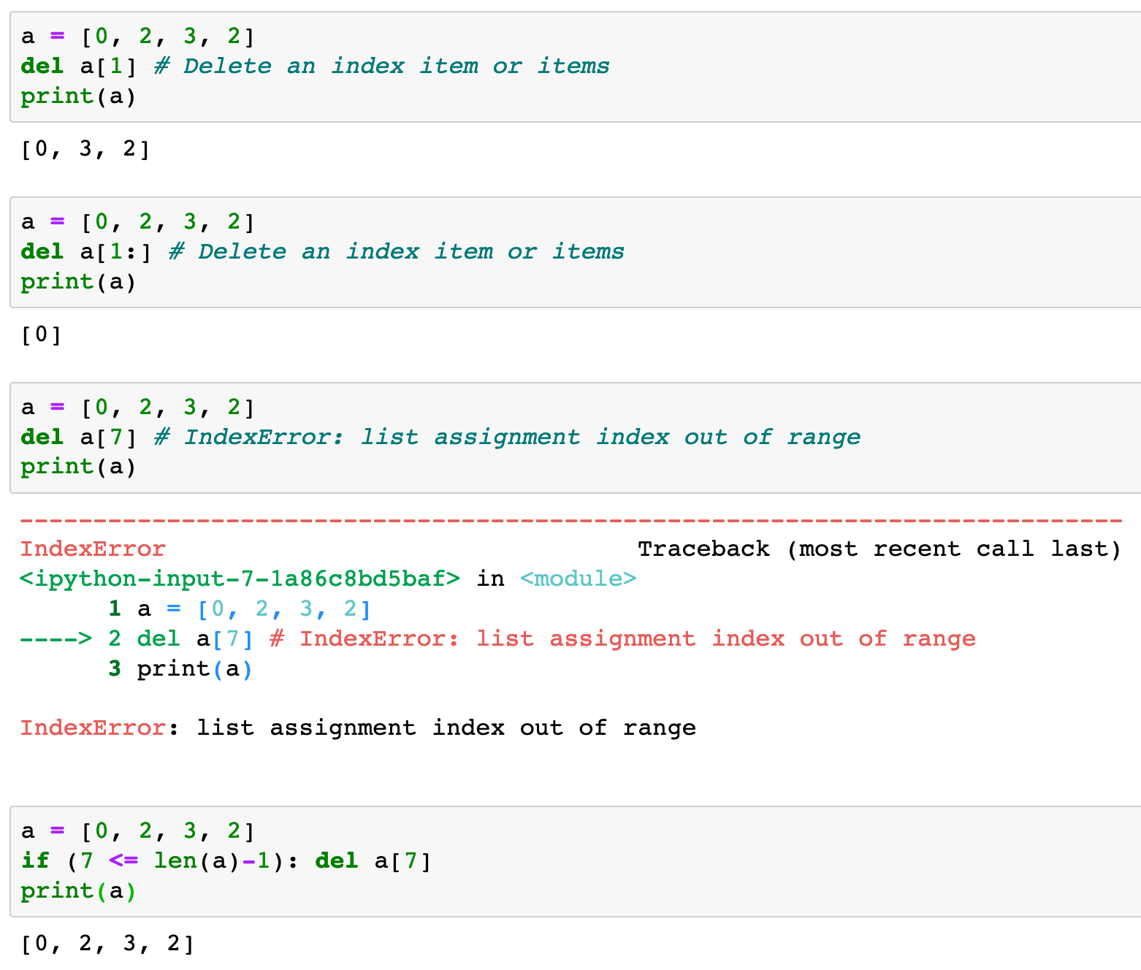

Slide 13
Pop an index item

Slide 14
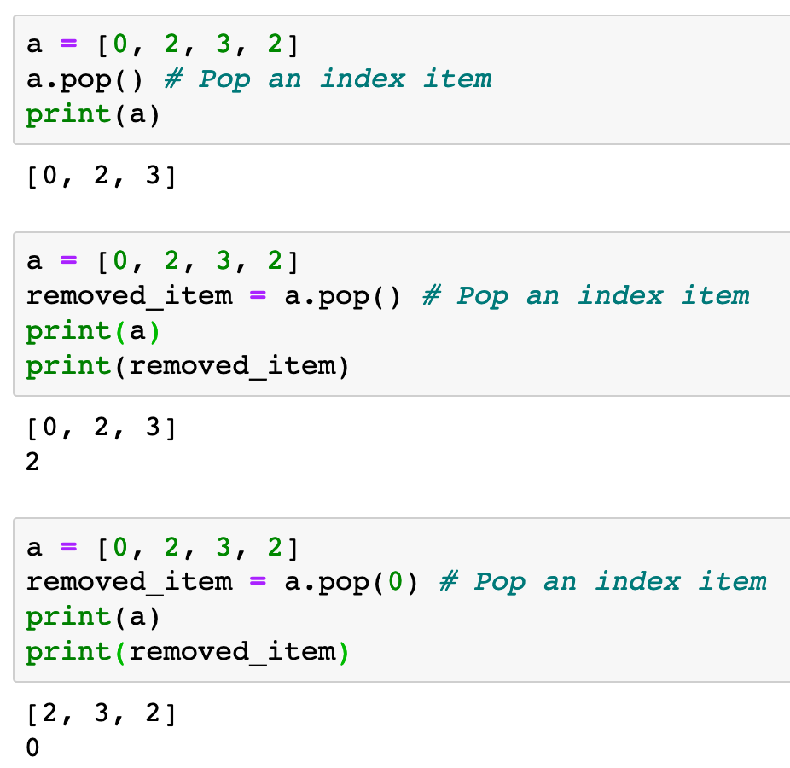

Slide 17
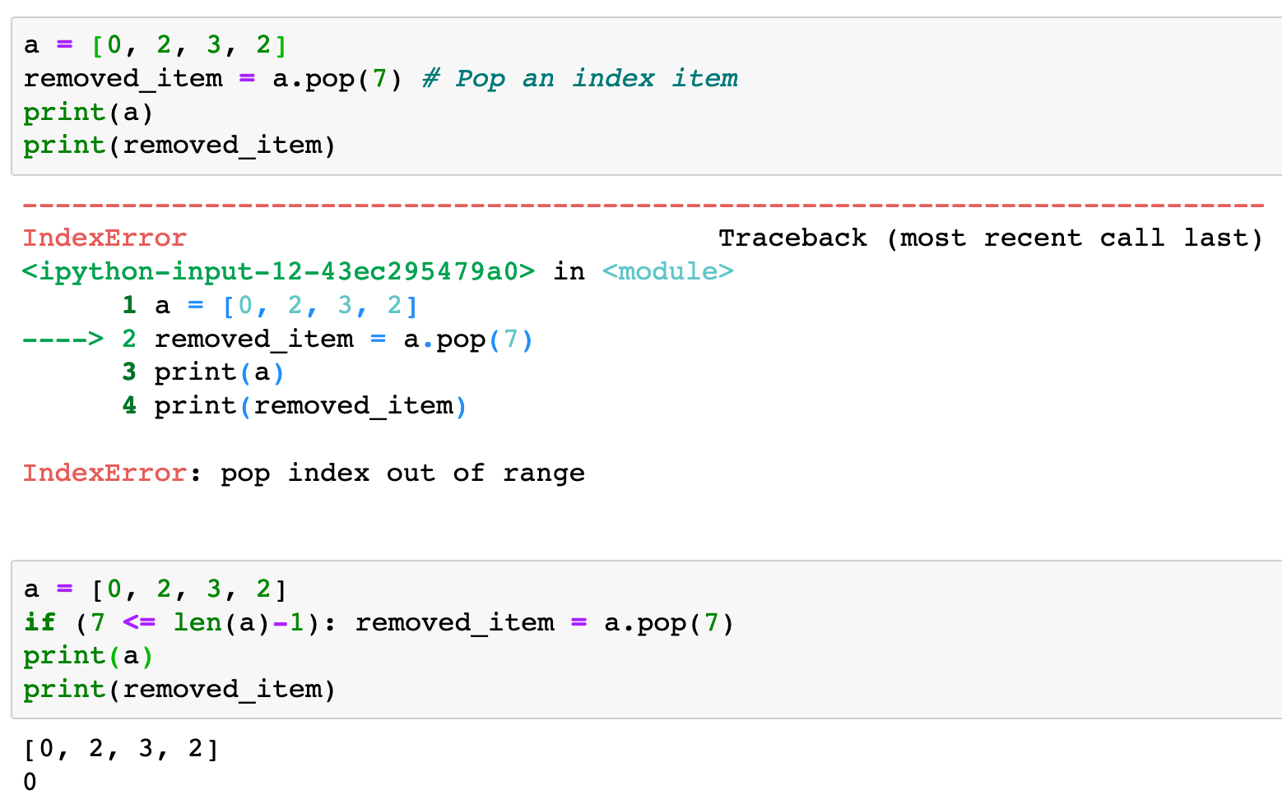

Slide 19
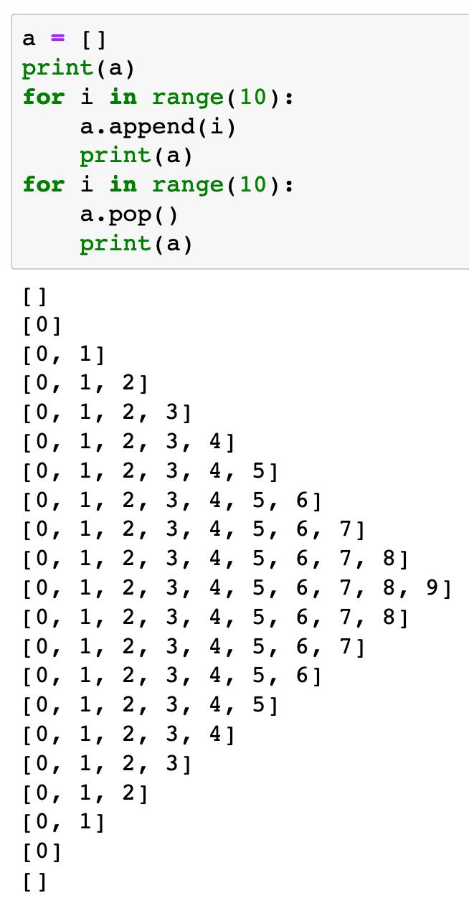

Slide 20
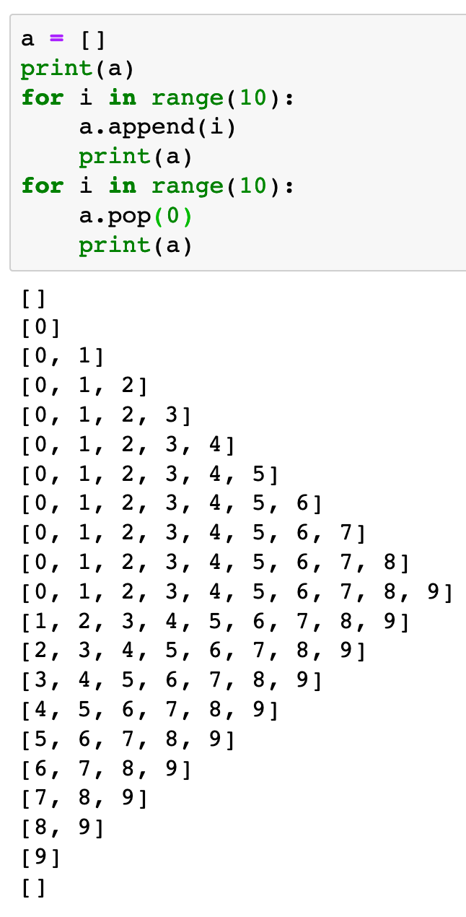

Slide 21
Now
Let’s Play with Code

